Slide 1
Problem Statement
We have been approached by an analytics consultant from a movie review website. They are writing up an article analyzing movie rating by critics and audience as well as movie budgets for the years 2007 to 2011
They have asked us to look at the data and provide them with 5 graphs. Given an excel sheet has information on movies, its genre, year in which they were released, Critic Rating(Rotten Tomatoes Rating) and Audience Rating.
The CEO has requested a specific graph that has to be included with the other 5 graphs. The diagram is supposed to look like this –
Audience Rating
Critic Rating

Slide 2
To visualize the data- R programming used
Graph 1 – scatter plot with faceting
x<-ggplot(data=movie,aes(x=Rotten.Tomatoes.Ratings..,y=Audience.Ratings..,colour=Genre))
x+geom_point(aes(size=Budget..million...))+facet_grid(Genre~Year)+geom_smooth()
Inference
Over the years (2011),audience has developed liking in Romance and Thriller movies but in years 2009-2010 the audience did not like those genres
Action, Drama and Comedy movies have been liked by the audience over the years

Slide 3
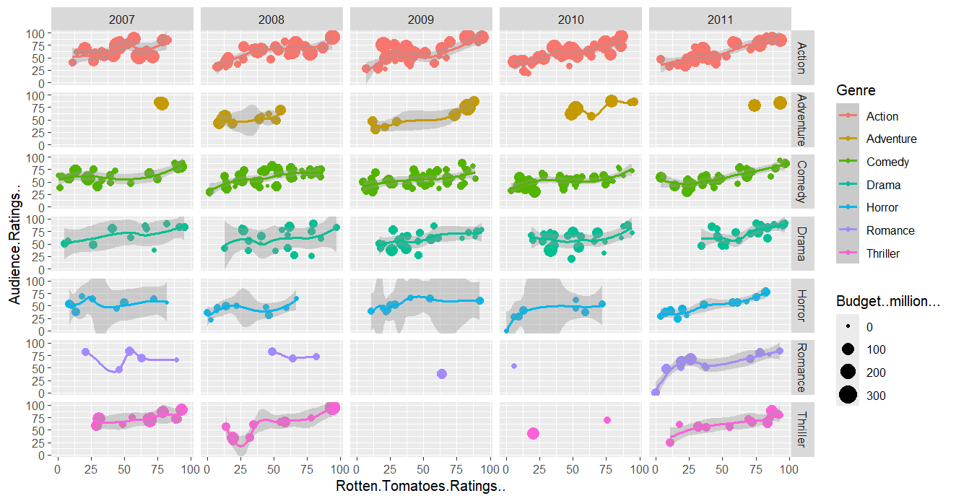

Slide 4
Graph 2 –box plot with scatter plot
v<-ggplot(data = movie,aes(x=Genre,y=Audience.Ratings..,colour=Genre))
v+geom_boxplot(size=1.2) #increases border size
v+geom_boxplot(size=1.2) + geom_point()
#tip- to make it look better
geom_jitterv+geom_boxplot(size=1.2) +
geom_jitter()
# to change the layering you change the order of layering
u+geom_point()+geom_boxplot(size=1.2)
#looks shabby
u+geom_jitter()+geom_boxplot(size=1.2,alpha=0.5) #aplha adds transparency
Inference
Thriller, Drama and Adventure have high Rotten Tomatoes Ratings and is liked by the audience as well
Romance has low critic rating but high audience ratings
Horror has comparatively low audience rating and critic rating

Slide 5
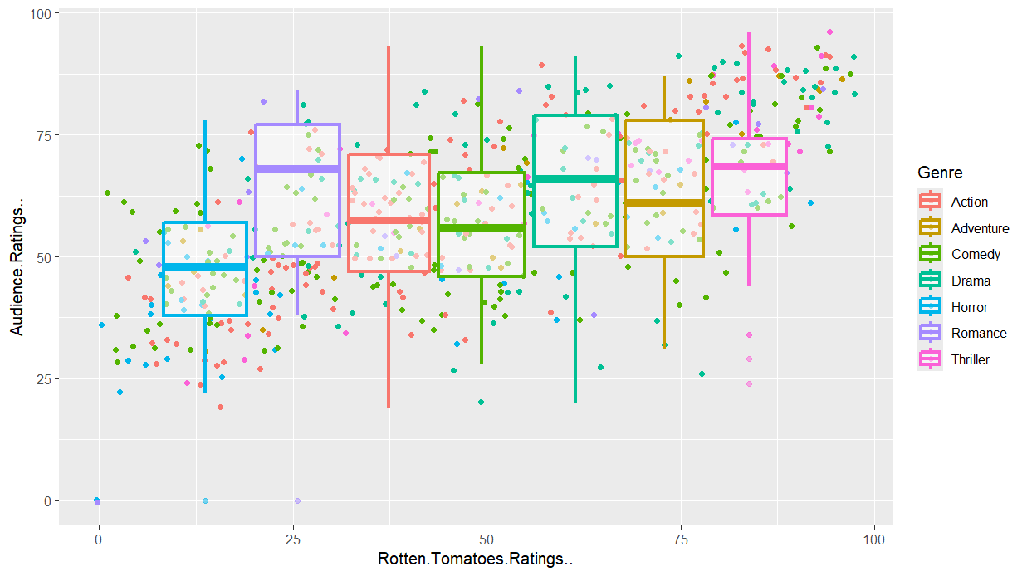

Slide 6
Graph 3:Histogram (Number of Movies VS Money Axis)
o<-ggplot(data=movie,aes(x=Budget..million...,))o+geom_histogram(binwidth=10,aes(fill=Genre))
i<-o+geom_histogram(binwidth=10,aes(fill=Genre),colour="Black")
i +xlab("Money Axis")+ylab("Number of Movies”)+
ggtitle("Movie Budget Distribution")+
theme(axis.title.x = element_text(colour="Dark Green",size = 20),
axis.title.y = element_text(colour="Red",size=20),
axis.text.x = element_text(size=20),
axis.text.y=element_text(size=20),
legend.title=element_text(size=20),
legend.text=element_text(size=20),
legend.position=c(1,1),
legend.justification=c(1,1),
plot.title=element_text(colour="Dark Blue", size=20,family="Courier"))

Slide 7
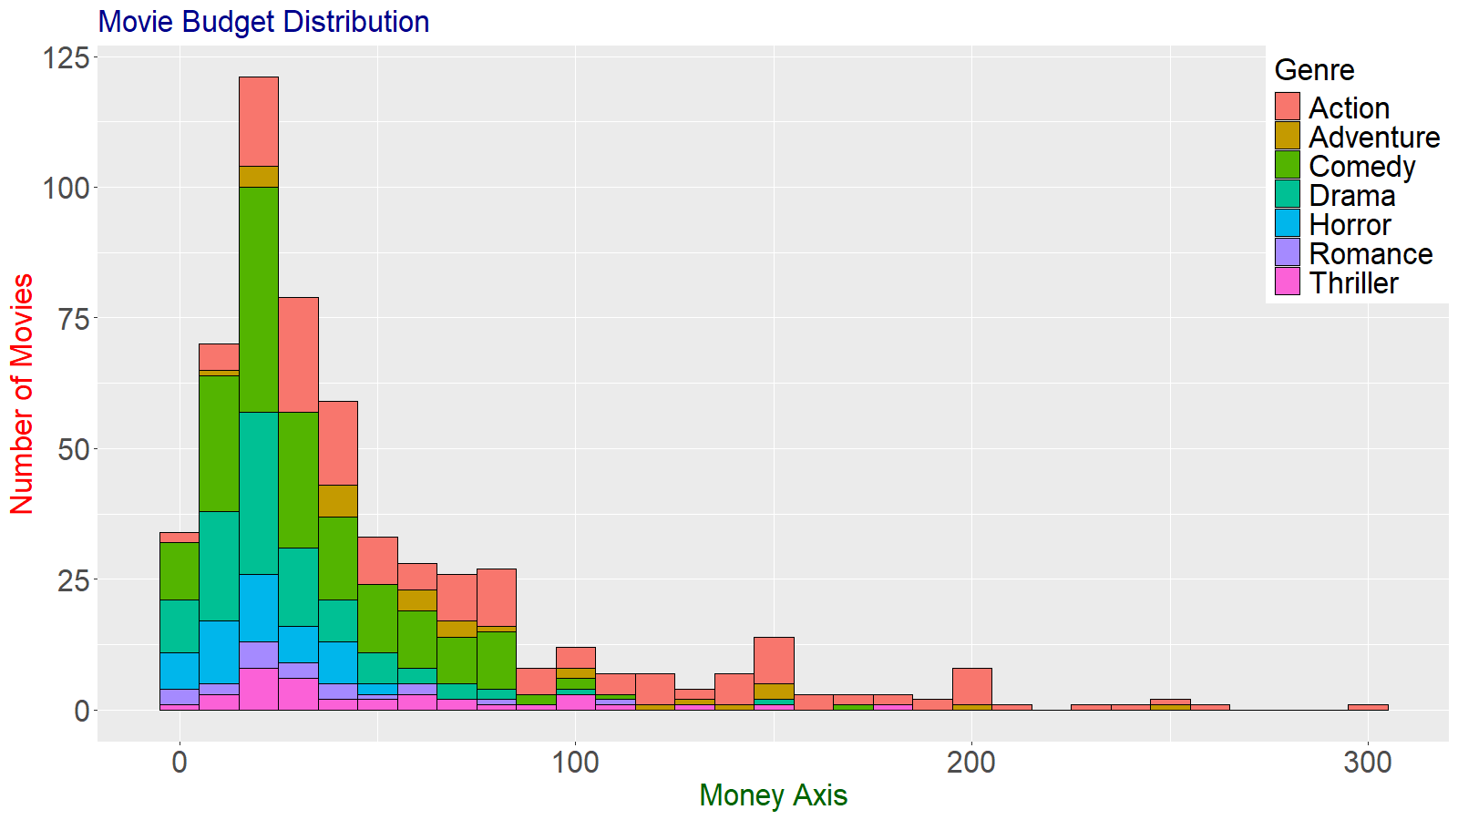

Slide 8
Graph 4:Histogram- Audience Rating
t<-ggplot(data=movie,aes(x=Audience.Ratings..))
t+geom_histogram(binwidth=10,fill="White",colour="Blue")
Inference
Maximum Rating- Over 100 movies have been rated by audience to be 50%
Minimum Rating- Very less movies have 100% rating

Slide 9
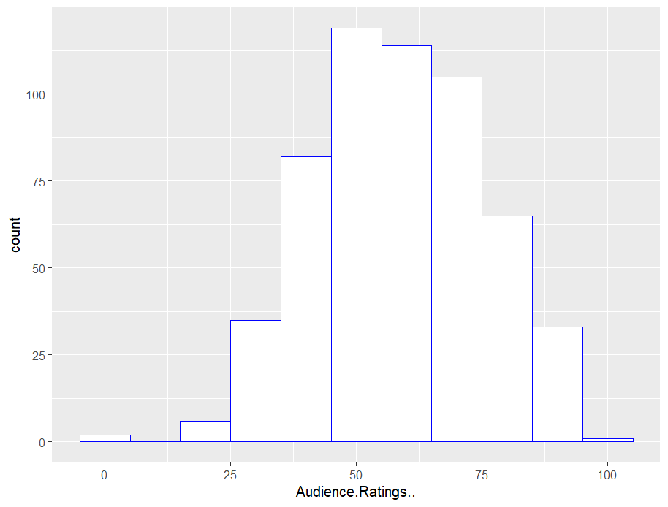

Slide 10
Graph 5:Histogram- Rotten tomatoes rating
t<-ggplot(data=movie,aes(x=Rotten.Tomatoes.Ratings..))
t+geom_histogram(binwidth=10,fill="White",colour="Blue")
Inference
Maximum Rating- Over 70 movies have 50% Rotten Tomatoes Rating
Minimum Rating- About 5-10 movies have 100% Rating

Slide 11
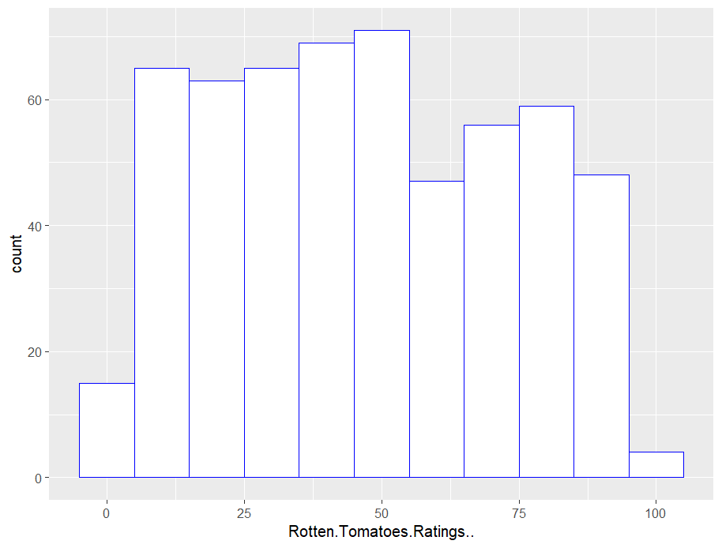

Slide 12
Graph 6:Scatter plot with respect to Genre and Budget
q<_ggplot(data=movie,aes(x=Rotten.Tomatoes.Ratings..,y=Audience.Ratings..,colour=Genre,size=Budget..million...))
q+geom_point(aes(size=Rotten.Tomatoes.Ratings..))

Slide 13
